Slide 1

Face ID Authentication for Banking
By
KNOWME https://github.com/balajishanmugamr/FaceRecognition.git
Team Members:
Balaji SHANMUGAM(balaji.shanmugam@epita.fr)
Siva SITHAMPARAPPILLAI(ssiva0204@gmail.com)
Jenoh JOHNSON(jenoh.johnson@epita.fr)
Anothkanth MAHENDRAN(anohanth@gmail.com)
Kathyayani ARULPRAKASH(kathyayani.arulprakash@epita.fr)

Slide 2
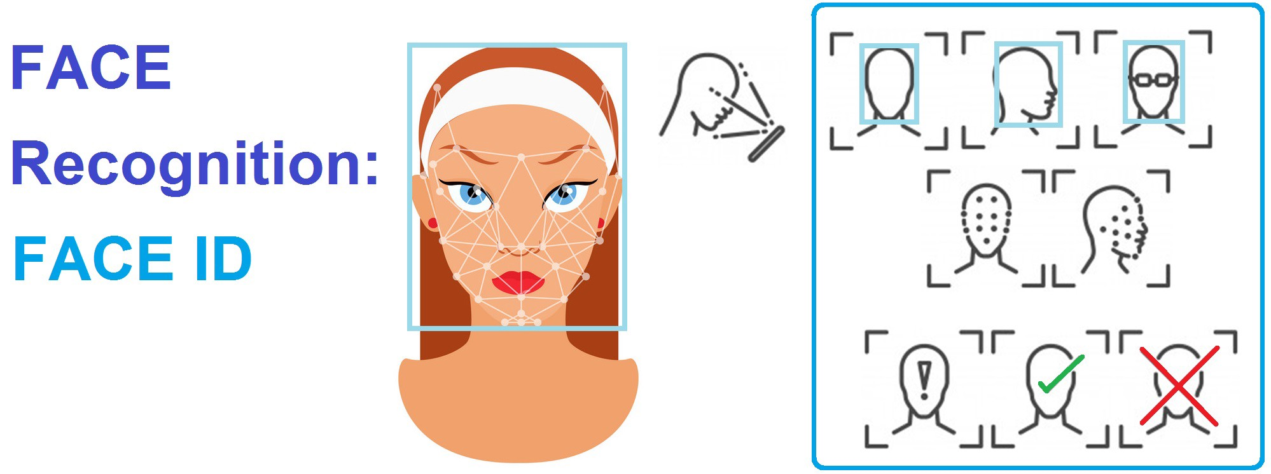
Description
While Banks have become sophisticated at using one-time passwords to access accounts or authorize transfers, there is still room for improvement. One possible solution is biometric identification via facial recognition technology. Instead of those one-time passwords, how about you could allow transactions by looking at your smartphone or computer. Biometric online banking is another of the benefits of face recognition.
With face recognition, there are no passwords that hackers could compromise. Even if hackers stole your photo database, it would be of little use, as “liveness detection,” to prevent using them for impersonation purposes. The benefits go beyond online, physical bank branches and ATMs can also make use of the technology. Thanks to it, using debit cards and signatures may soon be a thing of the past.

Slide 3
Data Flow
Start
Haar-cascade face detection
Collect reference face image
Vector Dimension Transformation
Dimension transformation of reference face image
Find k-near neighbor
Forever loop
Face recognition result
Capture from camera
Finish

Slide 4
Face detection is performed by using classifiers. A classifier is essentially an algorithm that decides whether a given image is positive(face) or negative(not a face). A classifier needs to be trained on thousands of images with and without faces. Fortunately, OpenCV already has two pre-trained face detection classifiers, which can readily be used in a program. The two classifiers are:
1. Haar Classifier
2. Local Binary Pattern(LBP) classifier

Slide 5
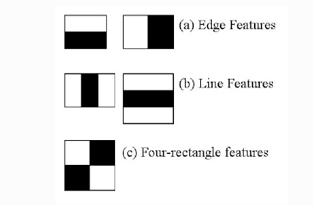
Haar Feature
Haar Features are kind of convolution kernels which primarily detect whether a suitable feature is present on an image or not.
Technologies Used:
Python,OpenCV,KNN,Cascade Classifier

Slide 6
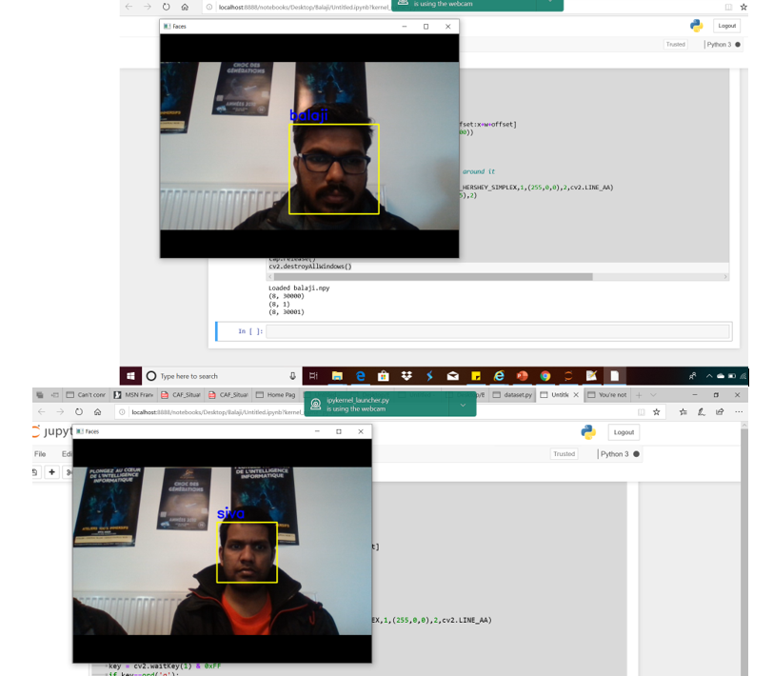
Sample Output

Slide 7
Conclution
The facial-recognition software helps minimize fraud where online hackers unlawfully use passwords and other data to steal from banking institutions. The software verifies a person’s identity by facial recognition before processing any transaction.

